Slide 1


CSB4202 - DATABASE MANAGEMENT SYSTEMS
B.Tech – III Semester
Dr. A. Antonidoss/Dr.Sathya Priya.S
Associate professor
School of Computing Sciences,
Department of Computer Science and Engineering

Slide 2
Entity Relationship Diagram
An Entity–relationship model (ER model) describes the structure of a database with the help of a diagram, which is known as Entity Relationship Diagram (ER Diagram).
An ER model is a design or blueprint of a database that can later be implemented as a database. The main components of E-R model are: entity set and relationship set.

Slide 3
Entity Relationship Diagram
What is an Entity Relationship Diagram (ER Diagram)?
An ER diagram shows the relationship among entity sets. An entity set is a group of similar entities and these entities can have attributes.
In terms of DBMS, an entity is a table or attribute of a table in database, so by showing relationship among tables and their attributes, ER diagram shows the complete logical structure of a database. Lets have a look at a simple ER diagram to understand this concept.

Slide 4
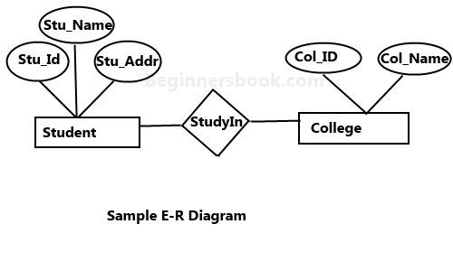
A simple ER Diagram:
In the following diagram we have two entities Student and College and their relationship.
The relationship between Student and College is many to one as a college can have many students however a student cannot study in multiple colleges at the same time.
Student entity has attributes such as Stu_Id, Stu_Name & Stu_Addr and College entity has attributes such as Col_ID & Col_Name.

Slide 5
A simple ER Diagram:
Here are the geometric shapes and their meaning in an E-R Diagram. We will discuss these terms in detail in the next section(Components of a ER Diagram) of this guide so don’t worry too much about these terms now, just go through them once.
Rectangle: Represents Entity sets.
Ellipses: Attributes.
Diamonds: Relationship Set.
Lines: They link attributes to Entity Sets and Entity sets to Relationship Set.
Double Ellipses: Multivalued Attributes.
Dashed Ellipses: Derived Attributes.
Double Rectangles: Weak Entity Sets.
Double Lines: Total participation of an entity in a relationship set.

Slide 6
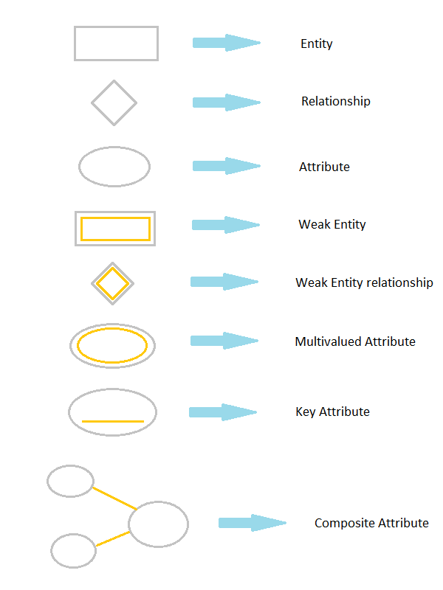
E-R Model Notations and Symbols :

Slide 7
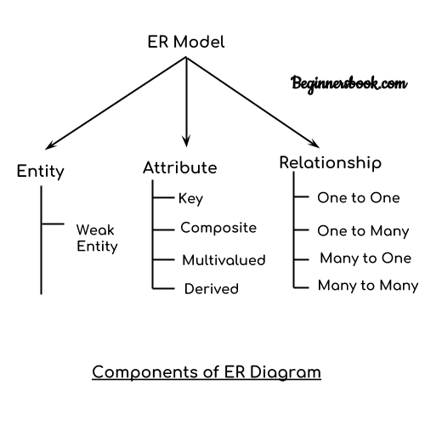
Components of a ER Diagram:

Slide 8

Components of a ER Diagram:
As shown in the above diagram, an ER diagram has three main components: 1. Entity 2. Attribute 3. Relationship
1. Entity
An entity is an object or component of data. An entity is represented as rectangle in an ER diagram. For example: In the following ER diagram we have two entities Student and College and these two entities have many to one relationship as many students study in a single college. We will read more about relationships later, for now focus on entities.

Slide 9
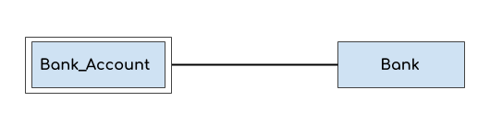
Components of a ER Diagram:
Weak Entity:
An entity that cannot be uniquely identified by its own attributes and relies on the relationship with other entity is called weak entity.
The weak entity is represented by a double rectangle.
For example – a bank account cannot be uniquely identified without knowing the bank to which the account belongs, so bank account is a weak entity.

Slide 10
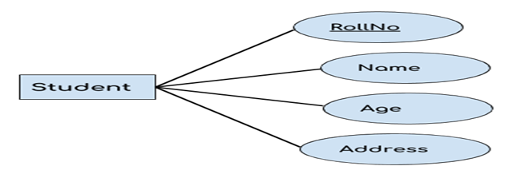
Components of a ER Diagram:
2. Attribute
An attribute describes the property of an entity. An attribute is represented as Oval in an ER diagram. There are four types of attributes:
1. Key attribute 2. Composite attribute 3. Multivalued attribute 4. Derived attribute

Slide 11
Components of a ER Diagram:
1. Key attribute:
A key attribute can uniquely identify an entity from an entity set. For example, student roll number can uniquely identify a student from a set of students. Key attribute is represented by oval same as other attributes however the text of key attribute is underlined.
2. Composite attribute:
An attribute that is a combination of other attributes is known as composite attribute. For example, In student entity, the student address is a composite attribute as an address is composed of other attributes such as pin code, state, country.

Slide 12
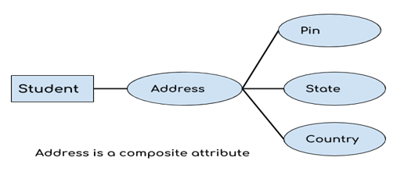
3. Multvalued attribute:
An attribute that can hold multiple values is known as multivalued attribute. It is represented with double ovals in an ER Diagram. For example – A person can have more than one phone numbers so the phone number attribute is multivalued.
Components of a ER Diagram:
3. Multivalued attribute:
An attribute that can hold multiple values is known as multivalued attribute. It is represented with double ovals in an ER Diagram. For example – A person can have more than one phone numbers so the phone number attribute is multivalued.

Slide 13
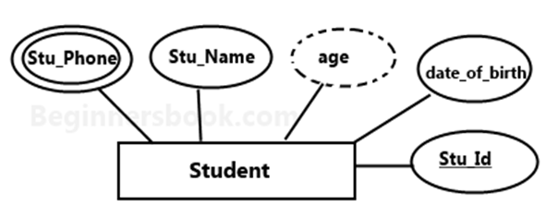
Components of a ER Diagram:
4. Derived attribute:
A derived attribute is one whose value is dynamic and derived from another attribute. It is represented by dashed oval in an ER Diagram. For example – Person age is a derived attribute as it changes over time and can be derived from another attribute (Date of birth).
E-R diagram with multivalued and derived attributes:

Slide 14
Components of a ER Diagram:
3. Relationship
A relationship is represented by diamond shape in ER diagram, it shows the relationship among entities.
There are four types of relationships:
1. One to One 2. One to Many 3. Many to One 4. Many to Many

Slide 15
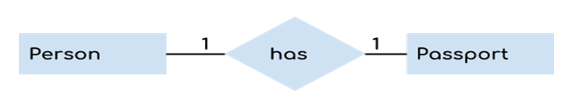
Components of a ER Diagram:
1. One to One Relationship
When a single instance of an entity is associated with a single instance of another entity then it is called one to one relationship. For example, a person has only one passport and a passport is given to one person.

Slide 16
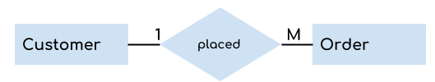
3. Many to One Relationship
When more than one instances of an entity is associated with a single instance of another entity then it is called many to one relationship. For example – many students can study in a single college but a student cannot study in many colleges at the same time. 3. Many to One Relationship
When more than one instances of an entity is associated with a single instance of another entity then it is called many to one relationship. For 3. Many to One Relationship
When more than one instances of 3. Many to One Relationship
When more than one instances of an entity is associated with a single instance of another entity then it is called many to one relationship. For example – many students can study in a single college but a student cannot study in many colleges at the same time.
3. Many to One Relationship
When more than one instances of an entity is associated with a single instance of another entity then it is called many to one relationship. For example – ma3. Many to One Relationship
When more than one instances of an entity is associated with a single instance of another entity then it is called many to one relationship. For example – many students can study in a single college but a student cannot study in many colleges at the same time.
ny students can study in a single college but a student cannot study in many colleges at the same time.
3. Many to One Relationship
When more than one instances of an entity is associated with a single instance of another entity then it is called many to one relationship. For example – many students can study in a single college but a student cannot study in many colleges at the same time.
an entity is associated with a single instance of another entity then it is called many to one relationship. For example – many students can study in a single college but a student cannot study in many colleges at the same time.
– many students can study in a single college but a student cannot study in many colleges at the same time.
Components of a ER Diagram:
2.One to Many Relationship
When a single instance of an entity is associated with more than one instances of another entity then it is called one to many relationship. For example – a customer can place many orders but a order cannot be placed by many customers.

Slide 17

3. Many to One Relationship
When more than one instances of an entity is associated with a single instance of another entity then it is called many to one relationship. For example – many students can study in a single college but a student cannot study in many colleges at the same time. 3. Many to One Relationship
When more than one instances of an entity is associated with a single instance of another entity then it is called many to one relationship. For 3. Many to One Relationship
When more than one instances of 3. Many to One Relationship
When more than one instances of an entity is associated with a single instance of another entity then it is called many to one relationship. For example – many students can study in a single college but a student cannot study in many colleges at the same time.
3. Many to One Relationship
When more than one instances of an entity is associated with a single instance of another entity then it is called many to one relationship. For example – ma3. Many to One Relationship
When more than one instances of an entity is associated with a single instance of another entity then it is called many to one relationship. For example – many students can study in a single college but a student cannot study in many colleges at the same time.
ny students can study in a single college but a student cannot study in many colleges at the same time.
3. Many to One Relationship
When more than one instances of an entity is associated with a single instance of another entity then it is called many to one relationship. For example – many students can study in a single college but a student cannot study in many colleges at the same time.
an entity is associated with a single instance of another entity then it is called many to one relationship. For example – many students can study in a single college but a student cannot study in many colleges at the same time.
– many students can study in a single college but a student cannot study in many colleges at the same time.
Components of a ER Diagram:
3. Many to One Relationship
When more than one instances of an entity is associated with a single instance of another entity then it is called many to one relationship. For example – many students can study in a single college but a student cannot study in many colleges at the same time.

Slide 18
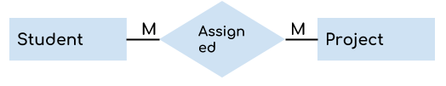
Components of a ER Diagram:
4.Many to Many Relationship
When more than one instances of an entity is associated with more than one instances of another entity then it is called many to many relationship. For example, a can be assigned to many projects and a project can be assigned to many students.

Slide 19
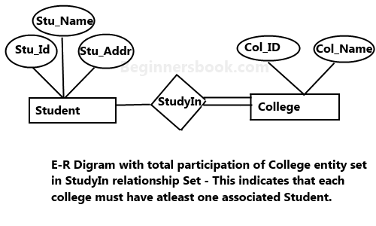
Total Participation of an Entity set
A Total participation of an entity set represents that each entity in entity set must have at least one relationship in a relationship set. For example: In the below diagram each college must have at-least one associated Student.

Slide 20
Quiz
Which of the following gives a logical structure of the database graphically?
a) Entity-relationship diagram b) Entity diagram c) Database diagram d) Architectural representation

Slide 21
Quiz
Which of the following gives a logical structure of the database graphically?
a) Entity-relationship diagram b) Entity diagram c) Database diagram d) Architectural representation
Answer a

Slide 22
Quiz
The entity relationship set is represented in E-R diagram as
a) Double diamonds b) Undivided rectangles c) Dashed lines d) Diamond

Slide 23
Quiz
The entity relationship set is represented in E-R diagram as
a) Double diamonds b) Undivided rectangles c) Dashed lines d) Diamond
Answer d

Slide 24


Slide 25
The End

